Slide 1
Improve your SQL Server Performance in 7 Simple Steps
Common performance blockers in
SQL Server, and how to avoid them
Hugo Kornelis
SQLServerFast.com

Slide 2











Slide 3
Hugo Kornelis
I make SQL Server Fast

Slide 4
Hugo Kornelis
I make SQLServerFast.com
Blog: http://sqlserverfast.com/blog
Execution Plan Reference: http://sqlserverfast.com/epr
Resources (planned)
Deck and demo for this session will go there
Check twitter for exact link
Articles (planned)

Slide 5
Hugo Kornelis
I make SQLServerFast.com
I do other community things
Technical editor for various books
SQL Server Execution Plans, 3rd edition (“Real Soon Now”™)
11 years MVP (2006 – 2016, SQL Server/Data Platform)
Lots of other things

Slide 6
Hugo Kornelis
I make SQLServerFast.com
I do other community things
I work
Independent database consultant
Will do (almost) anything for money
Email: hugo@perFact.info
Twitter: @Hugo_Kornelis

Slide 7
Agenda
Avoid cursors
Use indexes
Make predicates sargable
Check data types
Consider covering indexes
Be aware of parameter sniffing
Control your code
Design your database

Slide 8
Avoid cursors
Cursors (and other row-based processing)
Describes the required steps
Process one row at a time
Familiar method for people with background in C#, VB.Net, Cobol, …
Limits freedom of SQL Server’s query optimizer

Slide 9
Avoid cursors
Set-based processing
Describes the desired end result
Processes all data at once
Different mindset – learning curve
Query optimizer can reorder to improve performance
Is ALMOST always (much) faster than row-based

Slide 10
Avoid cursors
DEMO

Slide 11

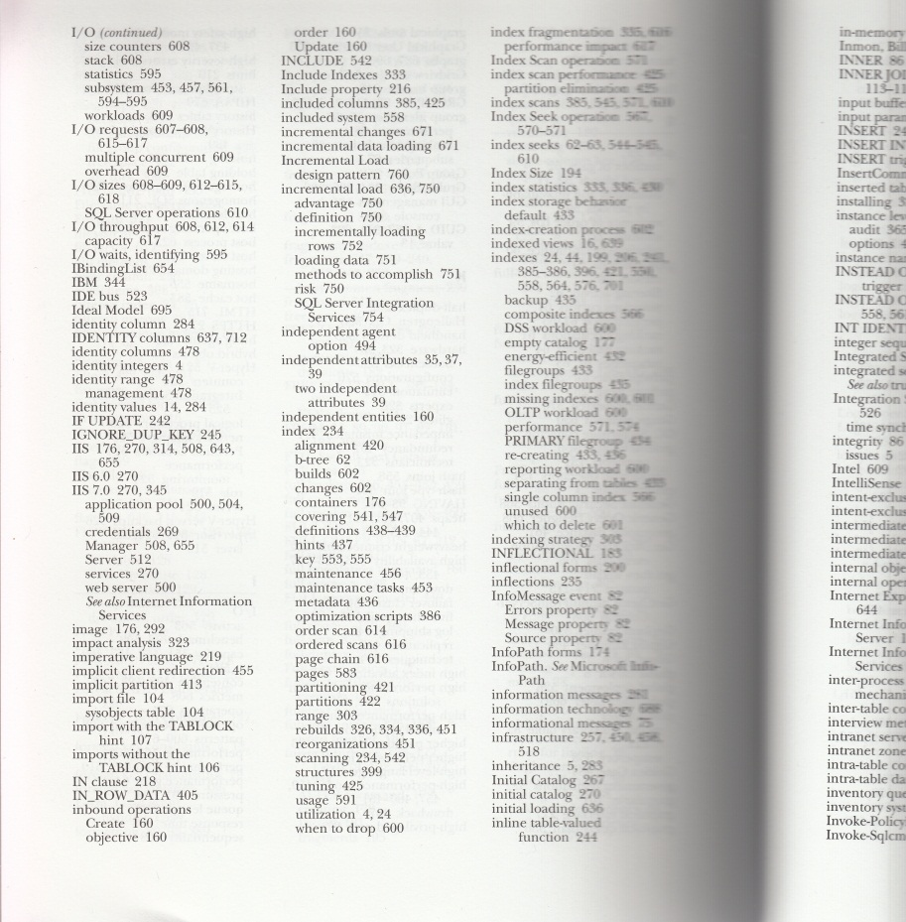
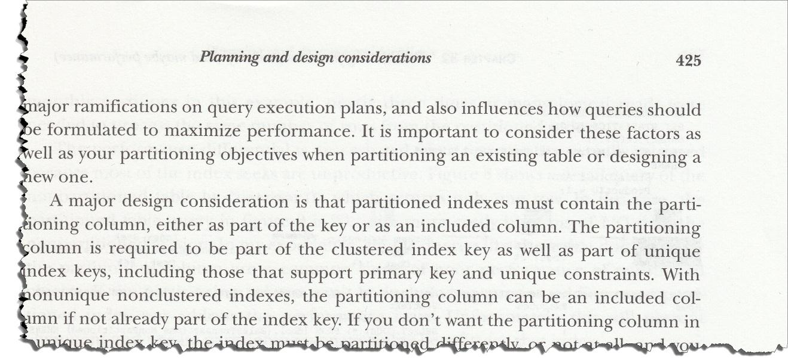
Use indexes

Slide 12
Use indexes
Indexes can help performance
Find required data faster
Requires filter on leading index column
Requires high selectivity (usually)
Rule of thumb: <5%

Slide 13
Use indexes
Indexes can also hurt performance
Modifying data slower
Indexes have to be updated as well
Impact on compilation time
Compilation time out
Overall system performance
Size on disk, in memory
Maintenance window

Slide 14
Use indexes
Good index candidates
FOREIGN KEY columns
Columns often used in filters
For specific, slow query
Query includes (selective) filter
Execution plan shows clustered index scan or table scan
PRIMARY KEY / UNIQUE: automatically indexed

Slide 15
Use indexes
DEMO

Slide 16
Make predicates sargable
“Predicate” ?
Official term for filter, condition, WHERE clause, …
“Sargable” ??
Search ARGument
Indexed column is on its own, not embedded in expression
Index can be used efficiently

Slide 17
Make predicates sargable
Signs of a sargability problem:
Usable index exists, but not used
Execution plan still contains table scan or clustered index scan
Index used, but not effectively
Execution plan uses index scan instead of index seek
Query uses indexed column as part of expression
Solution:
Rewrite the predicate to sargable form

Slide 18
Make predicates sargable
DEMO

Slide 19
Make predicates sargable
Implicit data conversions can ruin sargability
Rules for data type conversions:
http://msdn.microsoft.com/en-us/library/ms190309.aspx
Example:
char_column = integer_expression
becomes
CONVERT_IMPLICIT(int, char_column) = integer_expression

Slide 20
Make predicates sargable
Signs of an implicit conversion problem:
Execution plan uses scan instead of seek
Query expression appears to be sargable
Inconsistent data types used
Execution plan contains “CONVERT_IMPLICIT”
SQL 2012 and above: warning symbol in plan!
Solution:
Use consistent data types, or add explicit type conversions

Slide 21
Make predicates sargable
DEMO

Slide 22
Consider covering indexes
Drawback of traditional indexes
Finding qualifying rows is fast
Getting extra data requires an extra step (“lookup”)
Covering index avoids the lookup
All data used for the query directly available in the index

Slide 23
Consider covering indexes
What data is stored in the index?
Clustered index:
Indexed columns → can be filtered on
All other columns
Nonclustered index:
Indexed columns → can be filtered on
Columns of the clustered index
Optionally: extra columns (INCLUDE)

Slide 24
Consider covering indexes
Signs that you might need a covering index:
Usable index not chosen by query optimizer
Index used, followed by lookup with lots of executions
Solution:
Add or include extra columns in existing index
(will negatively impact other queries using that index)
Add a new index to cover the query
(will negatively impact modification performance)

Slide 25
Consider covering indexes
DEMO

Slide 26
Be aware of parameter sniffing
Different optimization methods
Constant value in plan?
Statistics used to estimate number of matches for that value
Optimize execution plan for that estimate
Example: Gender → 46% male, 46% female, 1% unknown, 7% n/a
WHERE Gender = ‘Male’: not selective, don’t use index
WHERE Gender = ‘unknown’: very selective, use index seek

Slide 27
Be aware of parameter sniffing
Different optimization methods
Variable in plan?
Statistics used to estimate average number of matches per value
Optimize execution plan for that estimate
Example: Gender → 4 values; FirstName → 14,500 values
WHERE Gender = @Gender: not selective, don’t use index
WHERE FirstName = @FirstName: very selective, use index seek

Slide 28
Be aware of parameter sniffing
DEMO

Slide 29
Be aware of parameter sniffing
Different optimization methods
Parameter in plan? (stored procedures and functions only!)
Compile on first call, using value passed in
Store plan in cache, reuse on subsequent call
Only recompile when required
Cache flushed after memory pressure
Change in statistics or metadata

Slide 30
Be aware of parameter sniffing
Benefits of parameter sniffing
Compile once, reuse often
Compilation can be expensive!
Less space in procedure cache used
More room for other plans and/or for data cache
Sometimes better plan than generic “variable” method
Especially with inequality (eg. WHERE DateCol > @DateParameter)
Very often the same plan

Slide 31
Be aware of parameter sniffing
Drawbacks of parameter sniffing
Plan created on first call may not be optimal for all values
Common value gets slightly slower plan
Outlier value gets extremely slow plan
Parameter sniffing issues can be hard to identify and reproduce
Recompiles can occur at seemingly random moments

Slide 32
Be aware of parameter sniffing
DEMO

Slide 33
Be aware of parameter sniffing
Common patterns
Equality filter
Parameter sniffing can be bad when data distribution is skewed
Inequality filter
Parameter sniffing can be very good
Optional parameters
Even conditional logic gets optimized on first call
Common example: search based on several optional parameters

Slide 34
Be aware of parameter sniffing
“Good” workarounds for bad parameter sniffing
Split procedure
Master procedure calls sub procedure as appropriate
One for generic case, one for specific value(s)
For multiple search, one for each possible combination
Can get out of hand if you allow too many combinations

Slide 35
Be aware of parameter sniffing
“Good” workarounds for bad parameter sniffing
Use query hint
OPTION (OPTIMIZE FOR (@parameter = value, …))
If you know that this value produces “good enough” plan
Requires ongoing maintenance
OPTION (OPTIMIZE FOR (@parameter UNKNOWN, …)
Use generic statistics (same as for “normal” variables)
OPTION (OPTIMIZE FOR UNKNOWN)
Shortcut for declaring ALL parameters unknown

Slide 36
Be aware of parameter sniffing
“Good” workarounds for bad parameter sniffing
Force a new plan every time
Plans always optimized for sniffed parameters
Compilation overhead
CREATE PROC xxx WITH RECOMPILE
Affects entire procedure
OPTION (RECOMPILE)
Affects specific query
Sniffs variables as well

Slide 37
Be aware of parameter sniffing
“Good” workarounds for bad parameter sniffing
Force a specific plan
Using “plan guide” with USE PLAN hint
Complex, out of scope
Using Query Store
SQL Server 2016 (and later)

Slide 38
Be aware of parameter sniffing
“Bad” workarounds for bad parameter sniffing
Copy parameters in local variables
All queries optimized using generic assumptions
Plan will be stable but might not be optimal
Same as OPTION (OPTIMIZE FOR UNKNOWN) on every query
Use hint where needed, instead of this sledgehammer method

Slide 39
Be aware of parameter sniffing
“Bad” workarounds for bad parameter sniffing
Try to force first call with known “good” values
Can be done by using startup stored procedure
Not safe: “magic” can cause plan to be removed from cache
Better to use OPTIMIZE FOR hint with known “good” values

Slide 40
Be aware of parameter sniffing
“Bad” workarounds for bad parameter sniffing
Using dynamic SQL
Security risk (“SQL injection”)
Can be done in safe way, IF YOU KNOW WHAT YOU’RE DOING!
See http://www.sommarskog.se/dynamic_sql.html
See also http://www.sommarskog.se/dyn-search.html
(for solutions specific for the optional search parameters)

Slide 41
Control your code
Do you control the database code?
Frameworks or libraries (such as O/R mappers)
Faster development or faster performance?
C# vs. C++ vs. C vs. assembly code
WPF vs. DirectX
O/R mapper vs. SQL

Slide 42
Control your code
Advantages of generators
Faster development
Single skillset needed
Disadvantages of generators
Usually suboptimal performance
Generated SQL hard to find, hard to read
Limited options to influence the generated code

Slide 43
Design your database
Benefits of normalization
No update anomalies
Usually better performance
Third normal form (3NF) often considered “good enough”
Fifth normal form (5NF) is actually much better!

Slide 44
Design your database
Basics of normalization
Functional dependency
Given a name, do I know the registration number?
No – multiple people can share a name
Given a registration number, do I know the name?
Yes (the answer might be “none”)
Functional dependency: Reg# → Name
Can be on multiple columns
E.g. {Year + Reg#} → Name

Slide 45
Design your database
Basics of normalization
Keys
Candidate Key
Column (or combination) that every other column in the table is functionally dependent on
Supersets of candidate key are also candidate key; can be ignored
Primary key (PRIMARY KEY constraint)
Alternate key (UNIQUE constraint)

Slide 46
Design your database
First Normal Form (1NF)
No repeating groups
No composite attributes
At least one key per table

Slide 47
Design your database
Second Normal Form (2NF)
No non-key column is functionally dependent on a subset of a key
Third Normal Form (3NF)
No non-key column is functionally dependent on a non-key column
Boyce-Codd Normal Form (BCNF)
No key column is functionally dependant on subset of key or non-key

Slide 48
Design your database
Higher normal forms
4NF: Multivalued dependencies
5NF: Join dependencies
DKNF: Determined by domain and key constraints
6NF: No non-trivial join dependencies
ONF: 6NF with some exceptions
http://www.pluralsight.com/courses/relational-database-design

Slide 49
T H E E N D
Questions?
Email: hugo@perFact.info
Twitter: @Hugo_Kornelis

